Slide 1
Land USE Plan & COMPREHENSIVE COMMUNITY PLAN
Matachewan First Nation
INTRODUCTORY COMMUNITY MEETING
December 2, 2024
Notes:
CATHY

Slide 2
PRESENTATION OVERVIEW
Introductions
Definitions and Benefits
Planning Objectives
Planning Phases
Community Involvement
Your Questions
Prize Draw
Notes:
CATHY

Slide 3
Introductions & planning team structure

Slide 4
INTRODUCTIONS & experience
Brunswick House First Nation (2017)
Mattagami First Nation (2019)
Netmizaaggamig Nishnaabeg / Pic Mobert (2020)
Apitipi Anishnabek (2022)
Pays Plat First Nation (2023)
Nunavut communities (NFP)
Notes:
CAROLINE, JOANNA

Slide 5
How we will work together
Chief & Council
Planning Team “the Doers”
Matachewan First Nation Staff
Planning & Engineering Consultants
Planning
Committee
Matachewan Director, Lands & Resources Manager, and Economic Development Officer
Notes:
CAROLINE

Slide 6
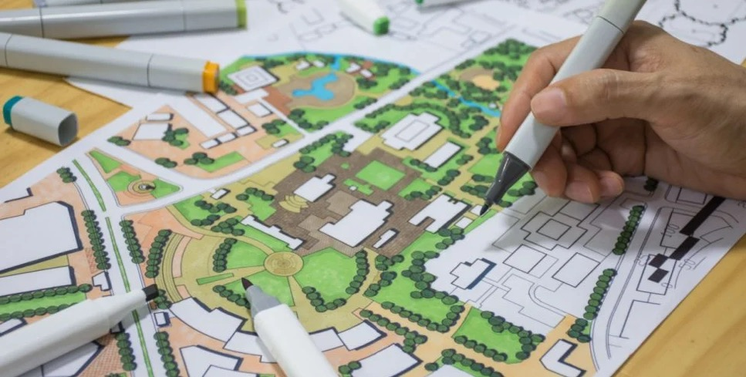
overview & benefits of planning

Slide 7
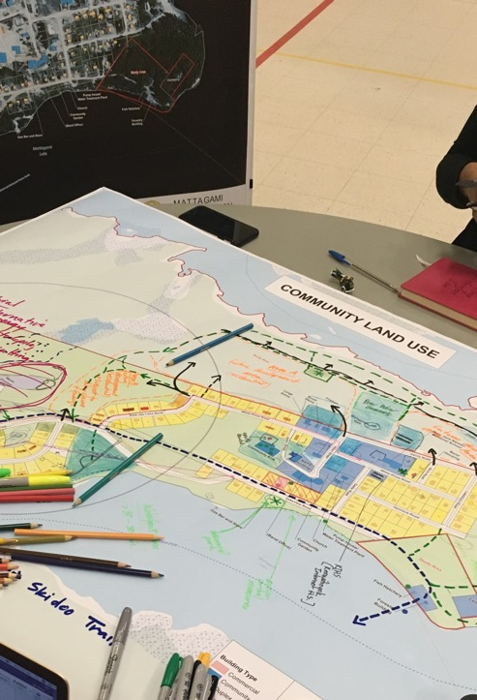
land planning…
Helps us UNDERSTAND current land use activities.
Envisions how land should be used in the FUTURE (20 year horizon is typical).
Proposes actions to make the VISION A REALITY.
Provides a FRAMEWORK to guide Chief & Council decisions on land management.
Tells a STORY about your community’s current and future reserve lands.
Notes:
CAROLINE Bring and point to examples of LUPs

Slide 8
Key Benefits
Uses community values to decide what new development can occur and where it is located
Protects environmentally and culturally important lands and water
Strengthens funding applications (Capital Planning, Infrastructure, Community development, etc.)
Can set a foundation for land management tools and self government processes (Development Law, Environmental Assessment Law, Land Code)
Notes:
CAROLINE, CATHY AND PAM

Slide 9
Some Objectives of Land planning
Guide decisions about what gets built and where
Ensure good quality housing, and community infrastructure to support growth
Identify and plan to adapt to climate change threats
Create a shared vision for the future
Protect culturally & environmentally significant lands and water
Avoid ad hoc development in new ATR lands
Create economic development areas with supporting infrastructure
Support future infrastructure and other community needs funding applications
Protect harvesting areas for future generations

Slide 10
A word about words . . .
Land USE Plan – what is it?
Importance of interconnectedness, interdependencies: “RELATIONSHIPS” with Land
Our goal:
DECOLONIZE land planning
Support connection to CULTURE through the planning process
Improve the QUALITY OF LIFE for those living and working on reserve lands
ENERGIZE members, leadership and staff to implementing the plan

Slide 11
deliverables
Background Report
Community features and history
Population projections
Community initiatives
Analysis of land needs
Infrastructure needs assessment
Community involvement process
Land Use Plan
Your vision
General & specific land policies
Evaluation criteria
Priority actions
Maps
Poster Plan
Poster reference map with general and specific use areas and policies

Slide 12
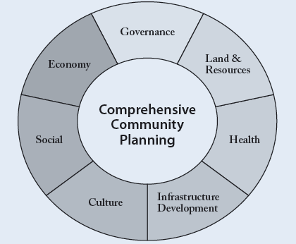
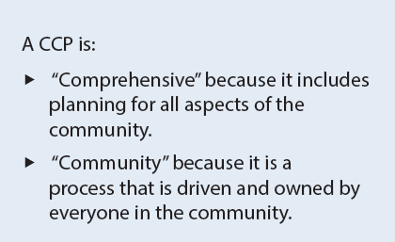
Comprehensive Community Plan
Source: ISC, CCP Handbook, 4th Edition (2018)

Slide 13
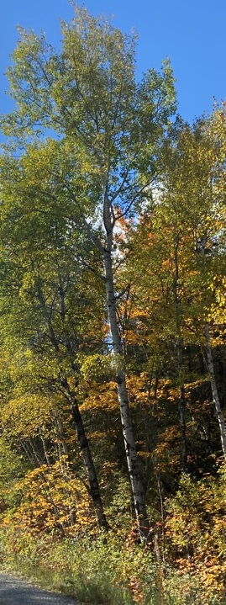
COMPREHENSIVE COMMUNITY PLAN
KEY COMMUNITY PILLARS:
Culture, social and health
Economic development and Limited Partnership
Governance
Infrastructure
Lands & Resources
Includes a goal for each pillar and actions to achieve the goals.
led by community planning committee with MFN staff with assistance as needed.
Community engagement events – at same time as for Land Use Plan.
Deliverable – to be determined by community
Notes:
Bring and point to examples of LUPs

Slide 14
Planning boundaries
Reserve and Additions to Reserve lands – LAND USE Plan
Insert image
MFN community and broader territory – CCP
Insert image

Slide 15
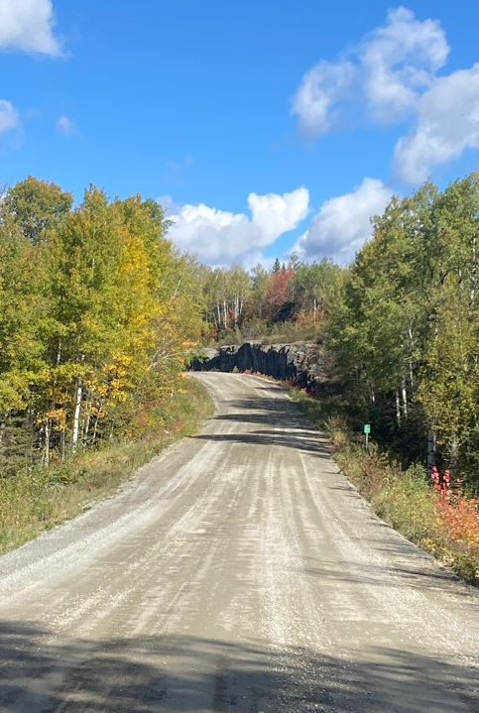
planning PHASES
Phase 1 – Pre-planning
(getting ready)
Phase 2 – Create the Plan
Phase 3 – Implementation
(Give life to the Plan)

Slide 16
Phase 1
PRE-PLANNING
October - December
2024
Pre-planning meeting (October 2024)
Prepare work plan, budget (Oct/Nov 2024)
Introductory community meeting (TONIGHT)
Visioning Survey (Dec 2024 – January 6, 2025)
Start Background Report
Notes:
Questions to consider in pre-planning:
What lands should be included in the Land Use Plan? All or part of the Reserve Lands?
Will the Plan include lands that are of interest for future additions to the Reserve?
Should the Plan consider how those lands will be used, protected or developed once they are added to the Reserve?
How will the Land Use Plan be funded?
How will we share the Land Use Plan with the community?
How will we engage the community and integrate their ideas into the Land Use Plan?
Will we need to create new jobs or training programs to implement the Land Use Plan?

Slide 17
Phase 2
PLAN
CREATION
January – March 2025
Prepare vision statement
Continue research and analysis for Background report
Base Mapping & Cultural Mapping Data
Community Planning Week (February 18 – 22, 2025)
Draft Land Use Plan, Poster Plan and Background Report
Community Engagement to review draft Land Use Plan
Notes:
Questions to consider in pre-planning:
What lands should be included in the Land Use Plan? All or part of the Reserve Lands?
Will the Plan include lands that are of interest for future additions to the Reserve?
Should the Plan consider how those lands will be used, protected or developed once they are added to the Reserve?
How will the Land Use Plan be funded?
How will we share the Land Use Plan with the community?
How will we engage the community and integrate their ideas into the Land Use Plan?
Will we need to create new jobs or training programs to implement the Land Use Plan?

Slide 18
Phase 3
IMPLEMENTATION
April 2025 +
Chief and Council adoption of FINAL Land Use Plan and CCP
Develop an Implementation Plan and Timelines
Establish Monitoring and Reporting
Undertake Zoning Bylaw or other Studies and Strategies
Notes:
Questions to consider in pre-planning:
What lands should be included in the Land Use Plan? All or part of the Reserve Lands?
Will the Plan include lands that are of interest for future additions to the Reserve?
Should the Plan consider how those lands will be used, protected or developed once they are added to the Reserve?
How will the Land Use Plan be funded?
How will we share the Land Use Plan with the community?
How will we engage the community and integrate their ideas into the Land Use Plan?
Will we need to create new jobs or training programs to implement the Land Use Plan?

Slide 19
Community involvement

Slide 20
PLANNING COMMITTEE
Provides guidance to the Planning Team
Leads engagement on CCP
Participates in and encourages community involvement in planning events
5 – 6 MFN members
Representing broad range of community views
Terms of Reference
Register interest with Cathy Yandeau by Dec 19, 2024

Slide 21
Community Planning SURVEY
Gathers member vision for the future of the community
Gathers information about interest in moving to the reserve and what types of housing is needed
Online survey, hard copy from Cathy
December – January
Prize incentives
Will draft vision statement for community feedback during planning week.

Slide 22
PLANNING WEEK
Many engagement events throughout the week
Hear a broad range of community values, ideas and priorities for the LUP and CCP
On- and off-reserve meeting locations
Concept plan by end of the week!!
Prize incentives
February 18 – 22, 2025

Slide 23
DRAFT PLAN AND CCP REVIEW
Share and gather community feedback on the draft LUP and CCP
On- and off-reserve engagement
Early March 2025
Matachewan Planning

Slide 24
YOUR QUESTIONS

Slide 25
MEEGWETCH!
For more information:
Cathy Yandeau, MFN Lands & Resources
landsresources@mfnrez.ca

